Slide 1




AI-Driven Multimodal Step-Up Authentication System
With Real-Time Deepfake and Voice-Clone Detection for FinTech Security
PRESENTER
PROJECT SUPERVISOR
INSTITUTION
Snigdha Dwivedi
Dr. Dileep Kumar Singh
Jagran Lakecity Univ
2023BTCSE018 | B.Tech CSE
Faculty of Science & Tech
Bhopal, Madhya Pradesh

Slide 2

Vulnerabilities in Incumbent Auth
Fragility of SMS OTP & Static Biometrics
Generative AI Threat Vector
SMS OTP Attacks: Intercepted easily via SIM-swap fraud, SS7 protocol exploits, and real-time phishing relays without any liveness check.
Deepfake Video Synthesis: Generative AI models can now synthesize photorealistic facial likeness in real-time video streams during KYC checks.
Static Face ID Spoofing: Vulnerable to simple presentation attacks including printed photos, high-res screen replays, and basic 2D face swaps.
Voice Cloning (TTS): Few seconds of audio reference enable attackers to clone victim voices, defeating static voice-biometric systems.
Industry gap: Current systems lack adaptive risk evaluation paired with real-time multimodal liveness verification.

Slide 3
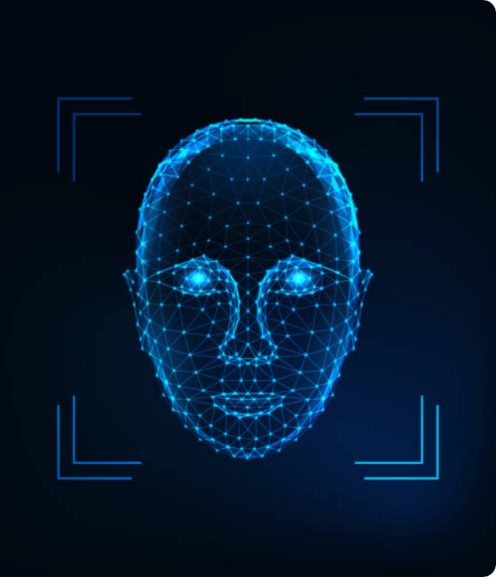
The "Look & Speak" Concept
Adaptive Risk-Driven Challenge
Instead of imposing uniform friction on every transaction, MSAS computes a real-time contextual risk score. Only transactions crossing risk thresholds trigger step-up authentication.
Dual-Modality Active Verification
The user undergoes a simultaneous 8-second visual liveness check ("Look") and dynamic spoken code phrase verification ("Speak") over WebRTC.
Fail-Closed Architecture
Any system timeout, network interruption, or signal ambiguity defaults strictly to Deny or Escalate, ensuring zero silent approvals under failure conditions.

Slide 4





Contextual Risk Evaluation Engine
Transfer Amount
Geolocation Velocity
Device Fingerprint
Compares transfer value against account baseline. Abnormally high amounts heavily weigh into cumulative risk.
Detects impossible speed travel or unverified IP locations relative to historical login hotspots.
Tracks rapid device-switching patterns and browser fingerprint anomalies prior to transfer initiation.
Risk Tiers & Actions
Time & Payee Context
Low Risk: Silent auto-approval without user friction.
Inconsistent time-of-day transaction attempts combined with first-time or watchlisted recipient accounts boost score to ensure maximum security for non-routine transfers.
Medium Risk: Triggers mandatory "Look & Speak" step-up.
High Risk: Step-up challenge + mandatory admin review.

Slide 5

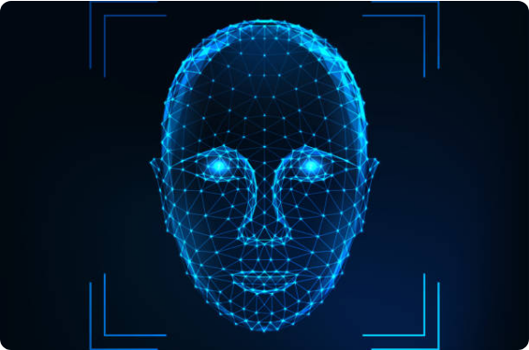
Visual Liveness Core (MediaPipe)
Eye Aspect Ratio (EAR) Blink Detection:
Extracts 468 facial mesh landmarks to monitor involuntary blinking cycles across consecutive video frames.
Randomized Head-Pose Prompts:
Instructs user to perform dynamic 3D head turns. Defeats flat photos and 2D video replays instantly.
Reticle Alignment Window:
Enforces bounding box alignment, preventing pre-recorded video positioning attacks.

Slide 6


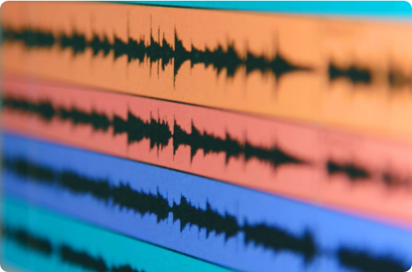

Audio Pipeline & Voice Authenticity
OpenAI Whisper ASR Code Verification
Transcribes spoken audio in real time and matches text against a dynamically generated, single-use phrase cached in Redis. Defeats static voice recording replays.
Voice Authenticity Classifier
Evaluates spectral power distribution, pitch stability, and acoustic phase anomalies to detect synthetic voice clones and TTS engine artifacts.

Slide 7

Multimodal Decision Fusion Rules
Visual Liveness | Spoken Code | Voice Authenticity | Risk Tier | Decision | System Rationale
Pass | Match | Authentic | Medium / High | ALLOW | All biometric factors verified; challenge passed cleanly.
Pass | Match | Flagged | Medium / High | ESCALATE | Possible synthetic voice clone; pending admin review.
Fail | Match | Authentic | Any Tier | DENY | Visual liveness failed; possible photo/video presentation attack.
Fail | Mismatch | Flagged | Any Tier | DENY | Simultaneous failure across modalities; account flagged.
*LLM Risk Reasoning engine generates explainable natural-language logs for all decisions.

Slide 8




System Architecture & Tech Stack
1. Client Layer
2. Application Layer
3. Intelligence Layer
Next.js & WebRTC: High-performance frontend capturing zero-latency camera/microphone media streams directly inside the browser.
Django REST Framework: Secure API gateway managing authentication sessions, WebRTC tokens, and API orchestration.
MediaPipe + Whisper + LLM: On-device vision landmark extraction, Whisper ASR, and decision fusion reasoning engine.
4. Data Layer Architecture
PostgreSQL (persisting user data, transactions & immutable logs) + Redis (caching nonces & session states).

Slide 9

Database Schema & Security Posture
Core Relational Tables
Privacy & Data Security
Table | Primary Key | Key Responsibilities
users | UUID | User profiles, salted password hashes, template pointers.
transactions | UUID | Payer/payee info, transfer amounts, risk scores.
multimodal_audit_logs | UUID | Immutable decision verdicts, rationale, media hashes.
Zero Raw Biometric Storage:
Raw photos/audio are destroyed immediately. Only irreversible mathematical embeddings are saved.
Tamper-Evident Audit Logging:
All auth attempts generate durable logs containing cryptographic hashes of verification artifacts.
Data Minimization & Compliance:
Aligned with IT Act 2000 and standard digital banking privacy guidelines.

Slide 10



Quality Attributes & Testing Matrix
Latency Budget
Scalability
WCAG 2.1 AA
End-to-end "Look & Speak" step-up verification completes under 3.0 seconds.
Supports at least 500 concurrent sessions with failure rates < 1%.
Captioned prompts, accessible contrast, and non-biometric fallback pathways.
Validation Test Matrix Highlights (IEEE Std 830)
Test ID | Attack Scenario / Condition | Input Test Vector | Expected System Response
TC-03 | Photo Spoofing Attack | High-res printed photo held in frame | DENY (No EAR blink / pose movement)
TC-05 | Deepfake Voice Clone | Synthetic TTS voice speaking code | ESCALATE (Spectral anomalies flagged)
TC-08 | Network Dropout Mid-Check | Dropped WebRTC socket connection | DENY (Fail-Closed policy enforced)

Slide 11




Development Timeline & Phased Roadmap
Month 1 - 3
Month 4 - 6
Month 7 - 9
Month 10 - 12
System Design & SRS: Requirements formulation (IEEE 830), risk scoring logic, and database architecture setup.
Phase 1 Deliverable: Build Risk Engine and Vision Core (MediaPipe liveness). Mid-Term Evaluation & Demo.
Phase 2 Build: Audio pipeline integration (Whisper ASR + Voice Authenticity Classifier) & Decision Fusion Engine.
Testing & Final Viva: Full test matrix execution (TC-01 to TC-10), security hardening, and final presentation.
Thank You!
Questions & Discussion | Snigdha Dwivedi (2023BTCSE018)

Slide 12


Image Sources
https://media.istockphoto.com/id/1166057711/vector/biometric-person-identification-facial-recognition-concept-futuristic-low-polygonal-human.jpg?s=612x612&w=0&k=20&c=bEePF402x94i0sHzgQ9kc8TSGb3jSs4DbeqIusyiIPM=
Source: www.istockphoto.com
https://www.altexsoft.com/static/blog-post-featured/2023/10/5a93ebe9-0acb-44fc-9007-caae8bf4f13a.jpg
Source: www.altexsoft.com

